Slide 1


Travel inSights
Suvechhya, Samiah, Kimberly

Slide 2
Who we are…
Travel inSights USA is a data‑driven tourism insights platform designed to analyze travel patterns and destination trends across the United States. We guide organizations and businesses to make smarter decisions on tourism growth, investment, and marketing.
Our goal is to clarify three W’s:
Who can our platform impact?
When is it the best time to travel?
Which destinations deserve more tourism?

Slide 3
Meet The Team
01
02
03
Suvechhya Gurung
Co-Founder
Background in data analytics. Expertise in data cleaning, Excel modeling, and trend analysis. Led all data processing and analytics for this project.
Co-Founder
Samiah Tabia
Background in data analytics. Skilled in data processing and data visualizations. Attention to detail and analytical mindset is valuable when working in a large industry such as tourism
Kimberly Sanchez
Co-Founder
Background in data analytics and business intelligence. Skilled in generating data insights for business decision-making and optimization. Insight-oriented approach to better understand traveler behaviors and trends.

Slide 4
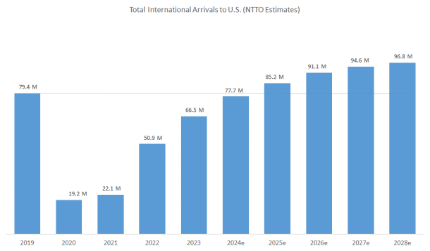
U.S. Tourism Industry Overview
U.S. travel spending projected to reach $1.35 trillion in 2025
Increase to $1.49 trillion by 2029
Domestic business travel to increase 1.4% in 2025
Expected to improve and exceed leisure travel rates in 2027-2029
Major driver of local economies and regional development

Slide 5

Our Audience
01
04
State Tourism Offices / Destination Marketing Organizations (DMOs)
They plan, promote, and measure tourism across states or regions — they need analytics to attract visitors and track ROI.
02
Local Convention and Visitors Bureaus (CVBs)
City-level organizations responsible for promoting local destinations and events — they need dashboards to show visitor growth and spending.
03
Economic Development Agencies (EDAs)
Public agencies that encourage investment and job creation through tourism and local business growth.
Regional Planning Commissions
Oversee multiple counties and rely on data to plan transportation, tourism, and infrastructure projects.
05
Small Business Alliances / Chambers of Commerce
Represent local tourism-dependent businesses (hotels, restaurants, attractions) that benefit from visitor analytics.

Slide 6
Datasets and Process:
Quantitative
Qualitative
Airline Traffic Data: https://www.kaggle.com/datasets/yyxian/u-s-airline-traffic-data
Provides insights to touristic travel trends and patterns from airline traffic across the years. Number of passengers, flights, and seasons will be used to highlight which local destinations are the most and least successful in their tourism activity.
U.S. Travel Destinations: https://www.kaggle.com/datasets/mosahle7/us-travel-destinations
Contains real traveler ratings across U.S. locations, cities, and attractions. Includes factoring details such as budget, descriptions, and favorite seasons which will enable sentiment analysis and text mining to uncover what visitors appreciate most in local destinations.
Remove Duplicates
Handle Blanks/Nulls
Format + Standardize data
Handle Outliers

Slide 7
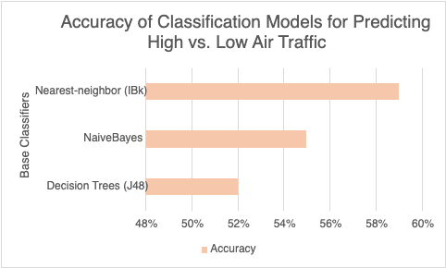
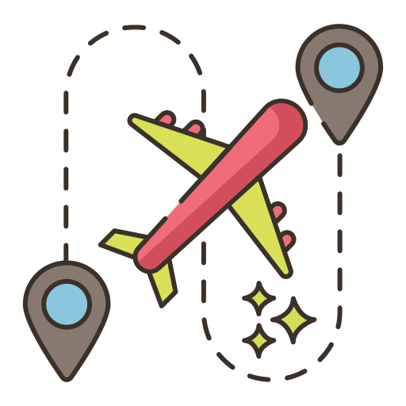
Classification Models: Accuracy of Air Traffic
IBk (k‑Nearest Neighbor): 59%
Naive Bayes: 55%
Decision Tree (J48) : 52%
Higher Flight Volume = Higher profit
Helps adjust marketing, staffing, and budgeting strategies.

Slide 8
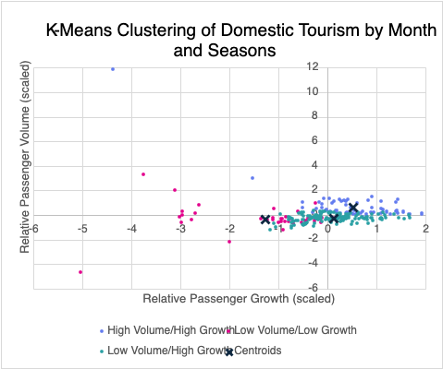
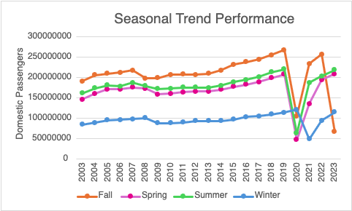
Seasonal Patterns in Domestic Tourism
Using our cleaned quantitative dataset, we can gain insights into when domestic tourism:
Experiences consistently strong traveling activity
Shows emerging months/seasons with potential for growth, promotion, and/or investments
Has seasons/months with a weaker traveling performance

Slide 9
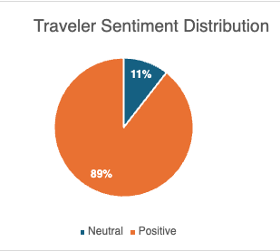
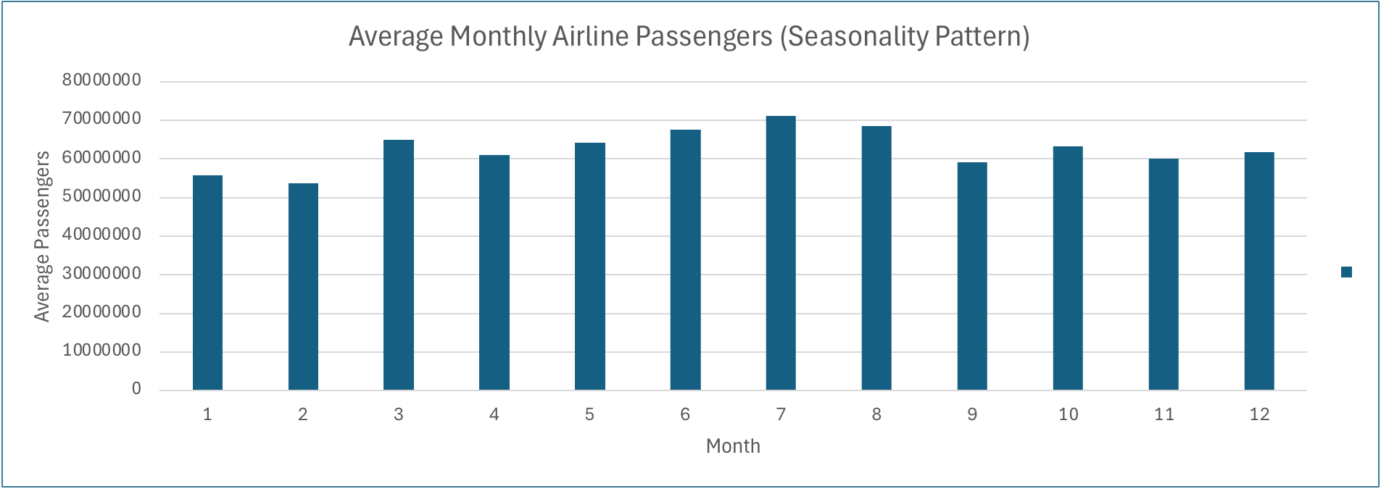
Sentiment Analysis/Traveler Insights:

Slide 10
How does Travel Insights succeed with this?
Who can our platform impact?:
Travel Insights can successfully support tourism businesses, travel planners, and travelers by providing insights that can contribute towards their decision making process and possible investments. We look into visitor sentiment analysis, ratings, demand, and patterns.
When is it the best time to travel?:
Our traffic predictions and seasonal charts reveal low and high traffic months and seasons that can guide travels to knowing when travel times are most favorable and successful and full in volume. In knowing the weakest months and seasons, business and travelers will also have insights towards which travel periods are not favorable and successful.
Which destinations deserve tourism?:
Our sentiment scores and analysis help reveal destinations with strong positive feedback. In tying our successful destinations with our low volume and growth, we can find travel opportunities along with investments and promotions for our audiences as well.

Slide 11
Thank You!

